Slide 1
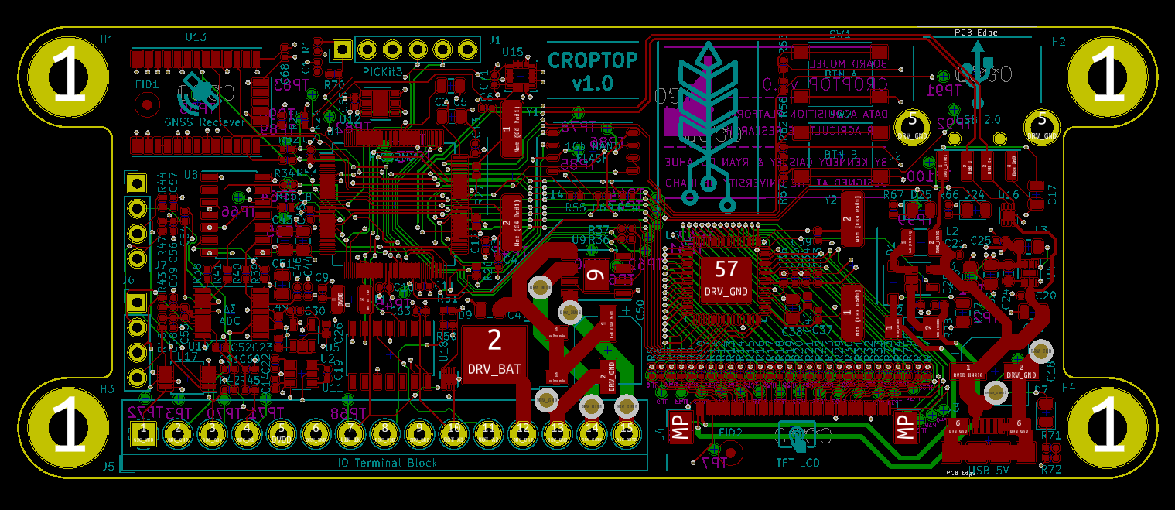
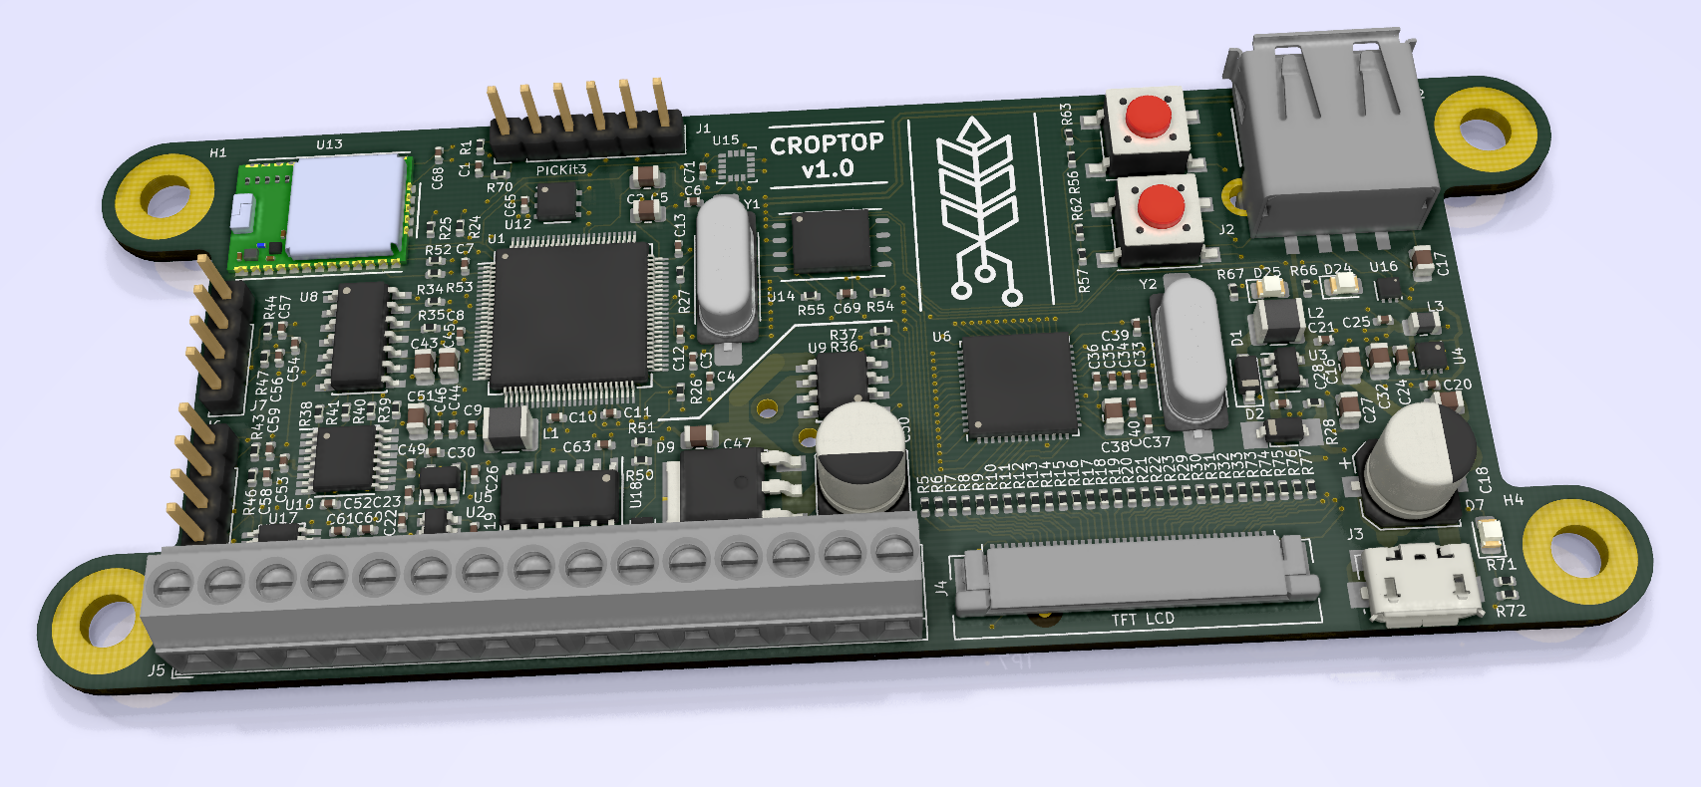

cereal grain Data Acquisition device
Technical specifications
24-bit Load Cell Interface X3
USB 2.0 Embedded Host Interface
Supports flash drives & barcode scanner
Rotary/Linear Encoder Interface
Configurable for 3.3V/5V
Ultrasonic Ranging Module Interface
Embedded Temperature and Humidity Sensor
Embedded Accelerometer
Provides tilt/angle of unit
uSD Card Interface
Embedded Graphic Processing Unit
Creates GUI on 800x480 7” TFT LCD
Supports resistive touchscreen
GNSS Receiver w/ Onboard Antenna
Provides time, date, and location data
microUSB Power Port
Onboard stepper motor driver
Onboard DC motor driver
Peripheral Header for Daughter Module
Project SCOPE
Wind-induced crop failure results in economic losses totaling tens of billions of dollars each year. A data acquisition computing platform has been designed that will enable researchers to understand this issue and breed more resilient crop varieties. The device features custom electronics hardware and embedded firmware, with an emphasis on design for manufacturability and reliability.
Design outcomes
Specification | Past Design | Current Design
Assembly rendering
Impact of design
Reduced BOM cost from $600 -> $150
Reduced assembly time from ~20hours to 1 hour
Improved battery life
Reduced weight
Improved data quality/resolution/accuracy
Added features
Self-calibration
Custom/simplified code base
Improved user ease-of-use/GUI
Improved device reliability/quality control
Meets IECE 61400-4 ESD Standards
Eliminated all mechanical user IO
Future directions
Acknowledgements
aCKNOWLEDGEMENTS

